Slide 1

DETECTING PARKINSON’S DISEASE
Using IBM Watson Machine
Learning Model

Slide 2
Team members:
N. Tulasi ram
N. Navya sri
P. Bhoomika
P. Jahnavi
T. Sai Manish

Slide 3
Parkinson's disease is a progressive nervous system disorder that affects movement. Symptoms start gradually, sometimes starting with a barely noticeable tremor in just one hand. Tremors are common, but the disorder also commonly causes stiffness or slowing of movement.
Although Parkinson's disease can't be cured, medications might significantly improve your symptoms. Occasionally, doctor may suggest surgery to regulate certain regions of brain and improve symptoms.
Common Symptoms
Tremor or the involuntary and rhythmic movements of the hands, arms, legs and jaw
Muscle rigidity or stiffness of the limbs – most common in the arms, shoulders or neck
Gradual loss of spontaneous movement, which often leads to decreased mental skill or reaction time, voice changes, decreased facial expression, etc.
Gradual loss of automatic movement, which may lead to decreased blinking, decreased frequency of swallowing and drooling
A stooped, flexed posture with bending at the elbows, knees and hips
Unsteady walk or balance
Depression or dementia
INTRODUCTION

Slide 4
INTRODUCTION
More than 10 million people are living with Parkinson’s Disease worldwide, according to the Parkinson’s Foundation.
While Parkinson’s cannot be cured, early detection along with proper medication can significantly improve symptoms and quality of life.
The researchers found that the drawing speed was slower and the pen pressure is lower among Parkinson’s patients.
One of the indications of Parkinson’s is tremors and rigidity in the muscles, making it difficult to draw smooth spirals and waves.
It is possible to detect Parkinson’s disease using the drawings alone instead of measuring the speed and pressure of the pen on paper.

Slide 5
PROBLEM STATEMENT:
TO DETECT PARKINSON’S DISEASE BY QUANTIFING THE SPIRALS AND WAVES DRAWN BY THEM.
Our goal is to quantify the visual appearance(using HOG method) of these drawings and then train a machine learning model to classify them.
In this project, We are using, Histogram of Oriented Gradients (HOG) image descriptor along with a Random Forest classifier to automatically detect Parkinson’s disease in hand-drawn images of spirals and waves.

Slide 6
Objectives:
Our project aim is to build a model which accurately detects the presence of Parkinson’s disease in an individual by taking the hand-drawn images of spirals as input.
For that firstly , we need to understand the problem to classify if it is a regression or a classification kind of problem.
Secondly , pre-process the image by using different data pre-processing techniques and use OpenCV and machine learning to automatically detect Parkinson’s disease in hand-drawn images of spirals and waves.
Build the web application using the Flask framework which runs in the localhost.
Finally , the model is deployed in the IBM cloud and is made available for the end users.

Slide 7
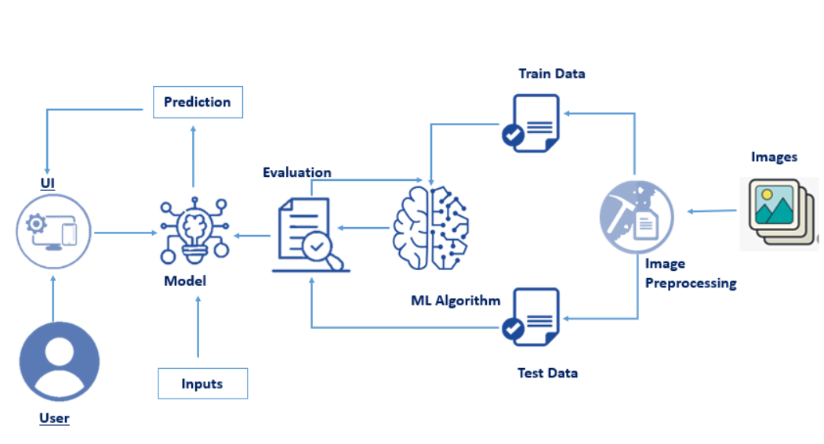
Architecture:

Slide 8
STEPS FOR BUILDING THE MODEL::
DATA COLLECTION:
Collect the required datasets of spirals and waves drawn by the Parkinson’s Diseased effected people.
IMAGE PREPROCESSING:
Load the required libraries for image processing
Load the collected data sets and quantify the images to the required size.
MODEL BUILDING:
Convert the data into binary format using Label Encoding
Now split the data into train and test and train the model
Test the model using required cv2 and hog libraries
Now save the model as pkl file

Slide 9
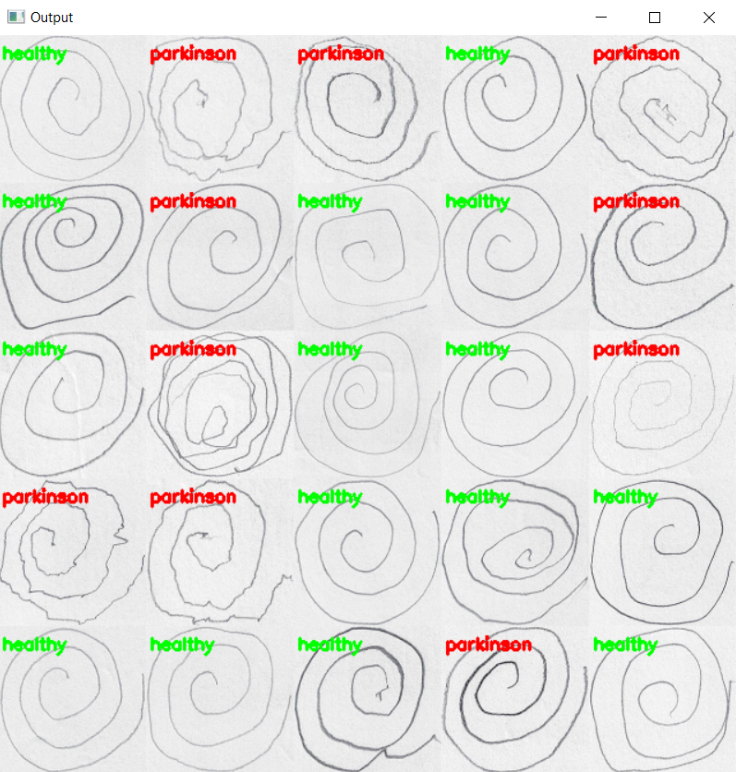
Output of the model building:
This is the output of the model evaluation
The output is displayed in the app used for model building
(eg:spyder,jupyter notebook)

Slide 10
Application Building:
Build the html pages for the web pages
Build the css for styling
Build the python code and connect the HTML and CSS files to the python code
Save the python code
Run the python code
Running the Python code:
Open the anaconda prompt
Navigate to the folder where your python code is saved
Now type python file_name.py
Python code will run and if there are no errors then the app.py will run in the port you have given in the code
Now in the browser type localhost:port_number given in the code
The web application for your trained model will open
Now predict the output by giving new patient’s observation images

Slide 11
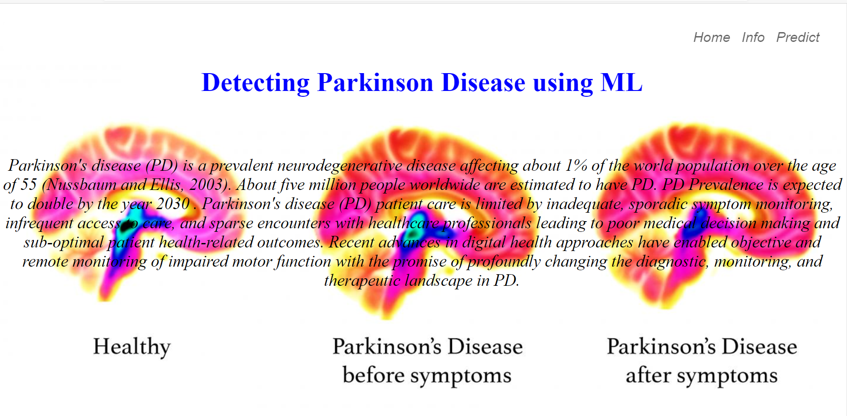
Home page
This will be the demo home page when you redirect to the localhost port

Slide 12
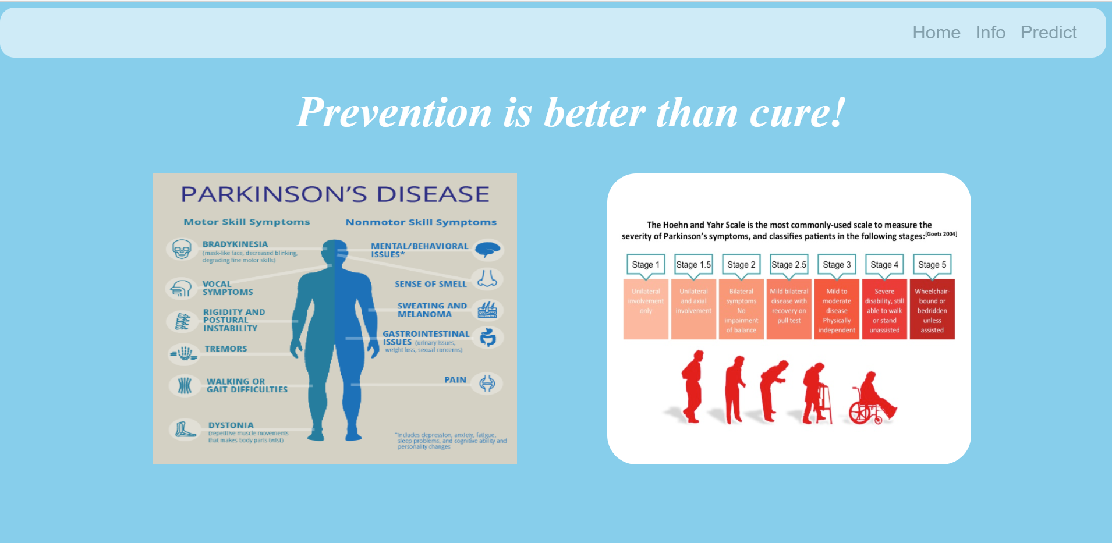
Info page
When you click info on the hover panel in your home page this page will be opened

Slide 13
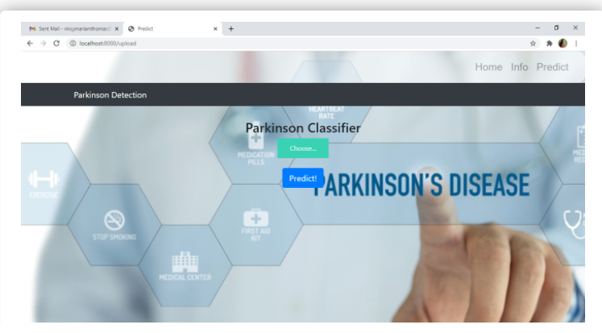
Predict page
This is predict page .
When you click on predict on the hover panel at the top this will be opened
In this page you will give the new patient’s observation images and predict whether that patient is healthy or parkinson

Slide 14
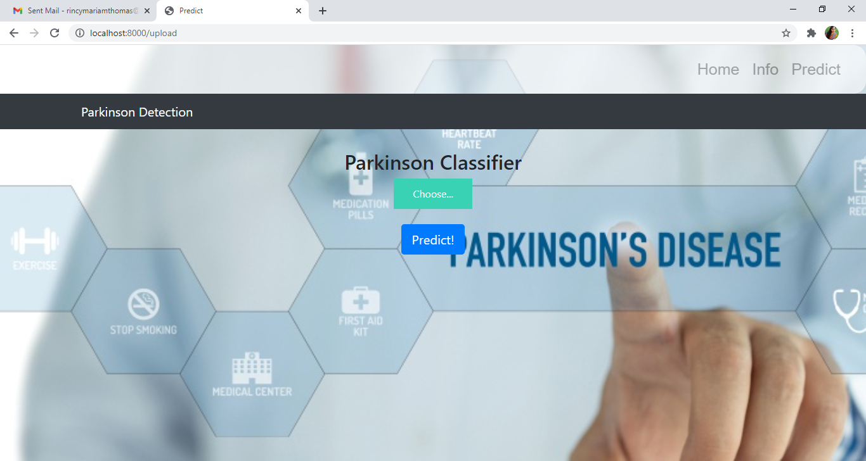
Running the app:

Slide 15
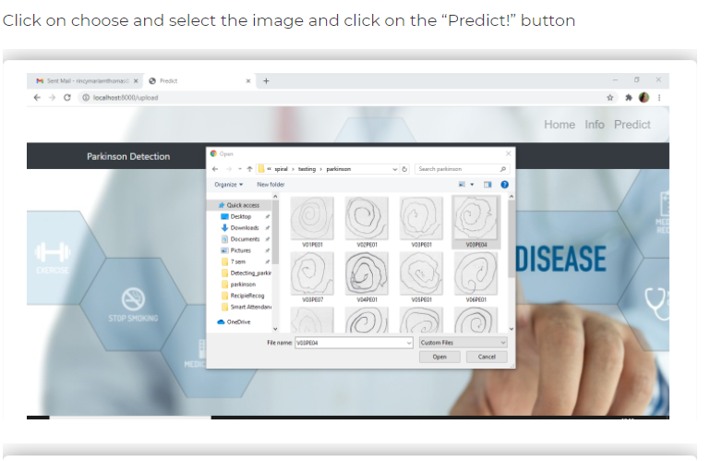

Slide 16
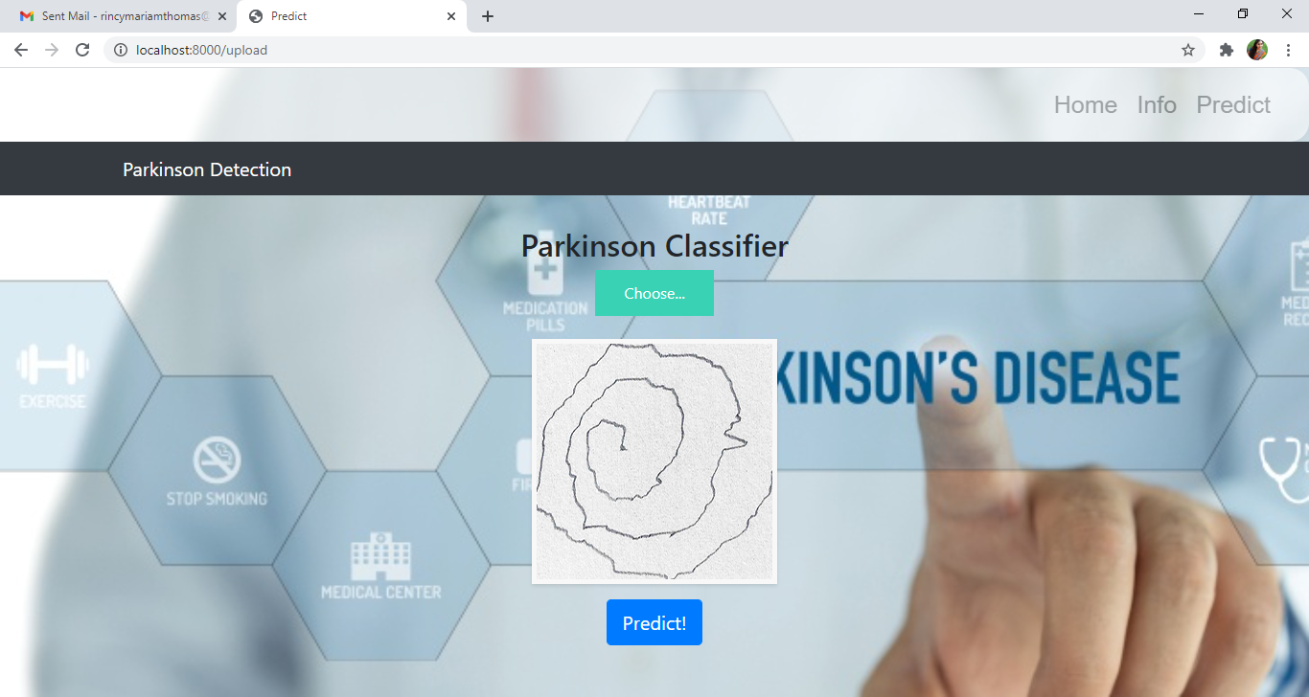

Slide 17
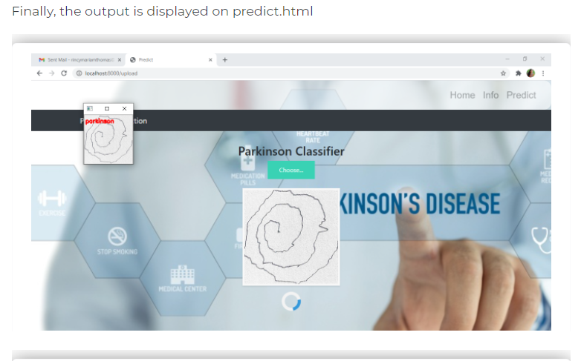

Slide 18
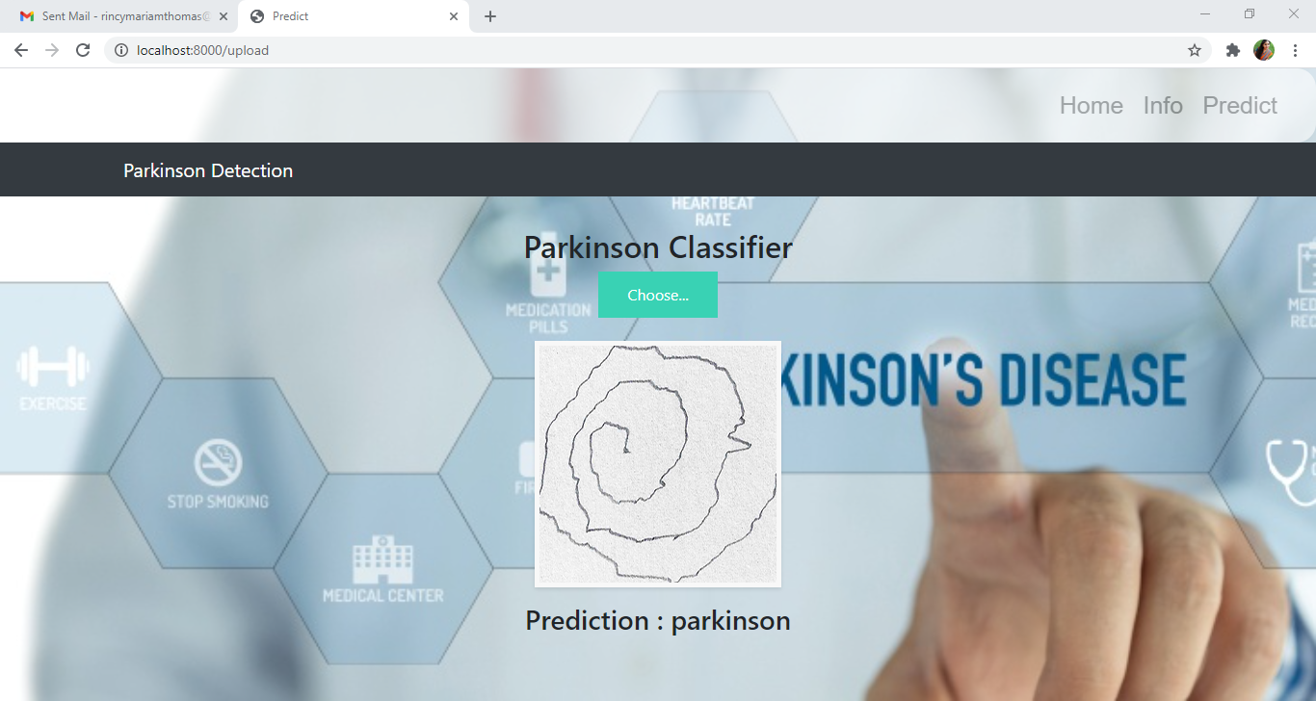

Slide 19
THANK YOU

